Slide 1
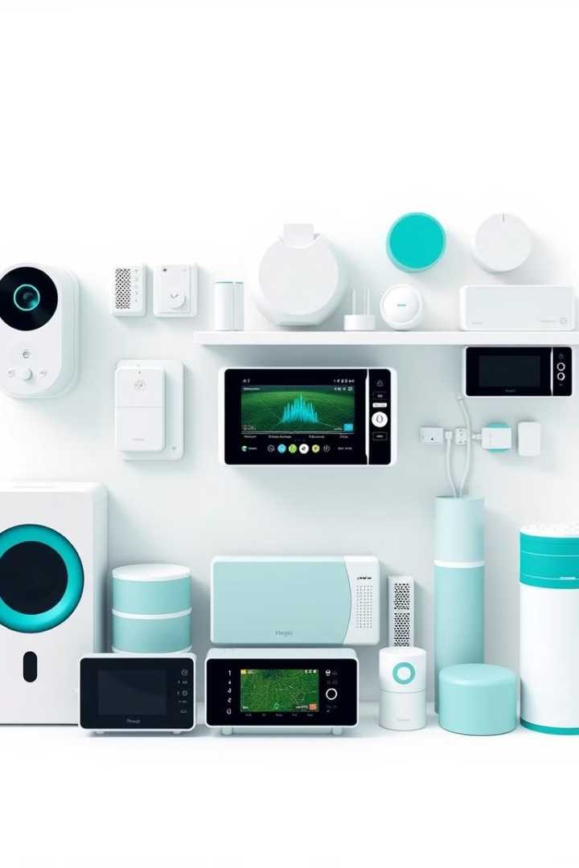
Real-Time Signal Processing using Automata in FPGAs for IoT Devices
This presentation explores the innovative use of automata and FPGAs to enable real-time signal processing in IoT devices, unlocking powerful capabilities for smart homes, industrial automation, and beyond.
BG
by BOGGAVARAPU GOWRINADH
G SIVAIAH

Slide 2
Introduction to IoT Devices and Challenges
Ubiquitous Connectivity
Real-Time Data Processing
Power and Resource Constraints
IoT devices are becoming increasingly prevalent, connecting our homes, cities, and industries to the digital world.
IoT devices must rapidly process vast amounts of sensor data to enable timely decision-making and response.
IoT devices often have limited power, memory, and computational resources, requiring efficient processing solutions.

Slide 3

Overview of Real-Time Signal Processing
1
Data Acquisition
IoT sensors continuously collect real-time data streams from the physical world.
2
Low-Latency Analysis
Rapid processing of sensor data to extract meaningful insights and enable immediate response.
3
Dynamic Adaptation
Ability to adapt signal processing algorithms to changing environmental conditions and application requirements.

Slide 4
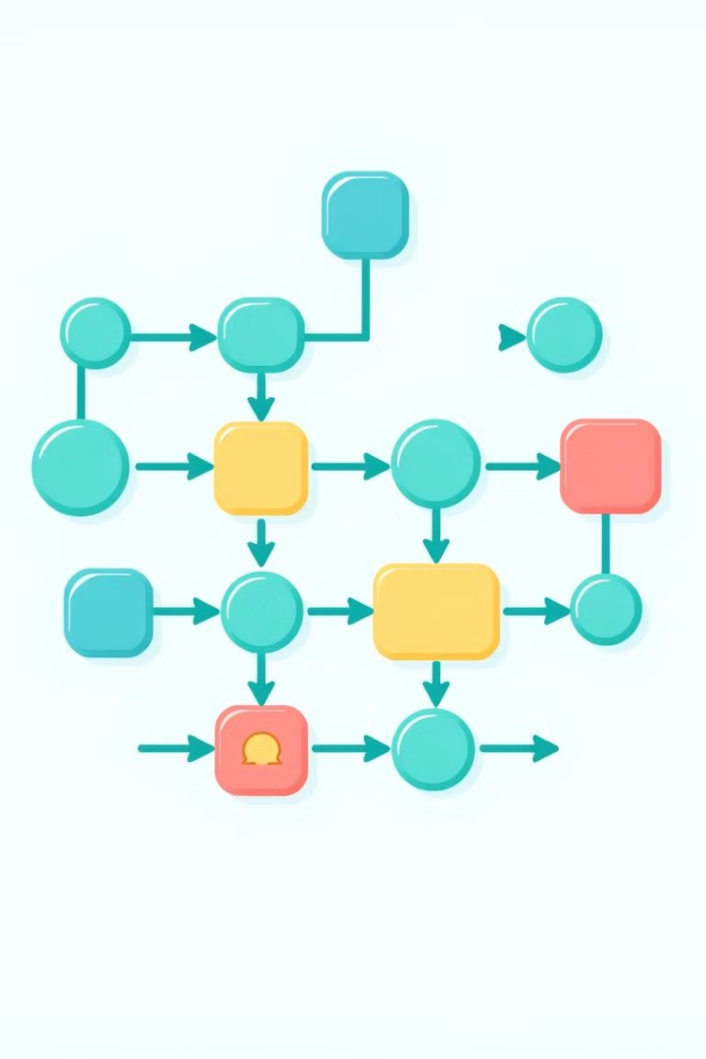
Automata Theory and Finite State Machines
Computational Models
Deterministic Behavior
Automata theory provides powerful computational models for real-time signal processing, including finite state machines.
Finite state machines offer a deterministic and predictable approach to processing streaming data.
Efficient Implementation
Automata-based designs can be efficiently implemented in hardware, such as FPGAs, for high-performance.

Slide 5
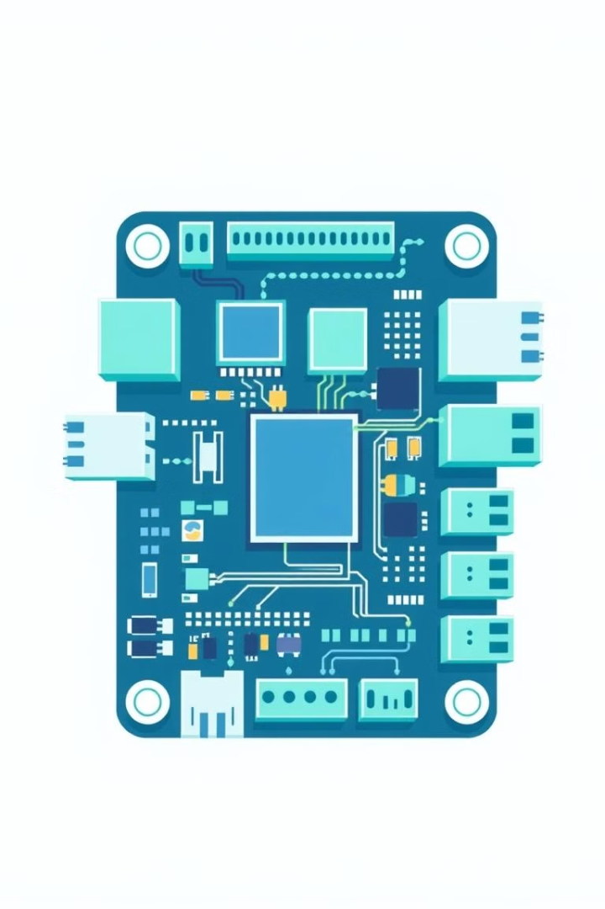



FPGA Architecture and Advantages
Reconfigurable
FPGAs allow for dynamic reconfiguration of hardware, enabling adaptation to changing requirements.
Parallel Processing
FPGAs can leverage their inherent parallelism to accelerate real-time signal processing tasks.
Low Power
FPGA-based solutions can deliver high performance with low power consumption, crucial for IoT devices.

Slide 6
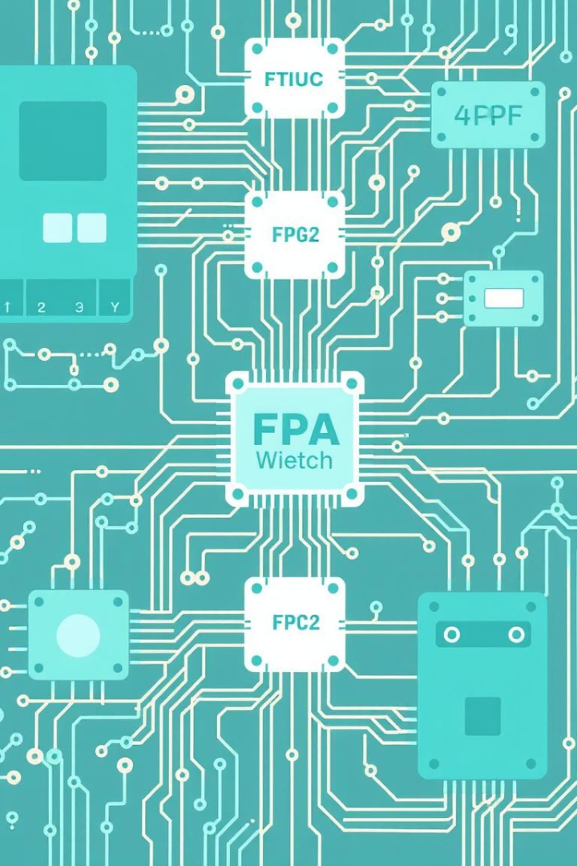



Optimization Techniques for Efficient Implementation
Pipelining
Dividing signal processing tasks into stages to improve throughput and latency.
Resource Sharing
Efficient utilization of FPGA resources by sharing logic and memory blocks.
Parallelism
Leveraging the inherent parallel nature of FPGAs to process multiple data streams simultaneously.

Slide 7
Applications and Case Studies
Industrial Automation
Smart Home Systems
Healthcare Monitoring
FPGA-powered IoT devices enabling real-time control, monitoring, and optimization of industrial processes.
Automata-based signal processing in IoT devices for intelligent home automation and energy management.
Efficient real-time analysis of medical sensor data using FPGA-based IoT devices for patient monitoring.

Slide 8

Conclusion and Future Directions
1
Continued Innovation
2
Increased Adoption
The integration of automata and FPGAs in IoT devices will drive further breakthroughs in real-time signal processing.
As the benefits of this approach become more widely recognized, we expect to see growing adoption across diverse industries.
3
Emerging Trends
Upcoming developments in areas like edge computing and energy-efficient hardware will further enhance the capabilities of FPGA-based IoT solutions.

